Slide 1

Indira College of Engineering and
Management Pune
Electricity Billing System
Project Submitted By
Nainesh Gopalrao Iche – 81107
Under the Guidance of
Dr. Darshana Desai Mam
(SRS)
Software Requirements Specification

Slide 2
INDEX :-
1 Introduction
2 System Requirements
3 Scope of Work
4 System Design And Modeling
4.1 Preliminary Design
4.1.1 E-R Diagram
4.1.2 Class Diagram
4.1.3 Activity Diagram
4.1.4 Use Case Diagram
4.1.5 Module Hierarchy Diagram
4.1.6 Sequence Diagram
5 Database Design
6 Conclusion
7 Snapshots

Slide 3
INTRODUCTION
This system is named as Electricity Bill Management System. This system is made to keep the records about the bills of the customers. The admin can manage all the accounts and the registered users, but the customers can only manage their own accounts. This system helps in maintaining the bills and the payments.
Admin and customers have a different interface and different privileges according to their need.
Like a customer can only manage his account and cannot see any details of other customers but admin can manage all the accounts.
This system also has the option for customers to pay their electricity bills by online mode.
This system also has the feature to add and delete customer account in case a customer wants to cut the connection.

Slide 4
ANALYSIS AND SYSTEM REQUIREMENT
Existing and Proposed System
The conventional system of electricity billing is not so effective; one staff must visit each customer’s house to note the meter readings and collect the data. Then, another staff must compute the consumed units and calculate the money to be paid. Again, the bills prepared are to be delivered to customers. Finally, individual customer must go to electricity office to pay their dues.
With the new system, there is reduction in the number of staffs to be employed by the company. The working speed and performance of the software is faster with high performance which saves time. Furthermore, there is very little chance of miscalculation and being corrupted by the staffs.
2.2 Software & Hardware Requirements
Hardware Requirements :-
Processor Intel Pentium V or higher
Clock Speed: -1.7 GHz or more
System Bus: -64 bits
RAM: -4GB
HDD: -500GB
Monitor: -LCD Monitor
Keyboard: -Standard keyboard
Mouse: -Compatible mouse
Software Requirements:
Operating System: -Windows 10
Software: - NetBeans IDE 8.2
Front End: -Java core/swings
Back End: -My SQL

Slide 5
Scope of Work
This project aims at serving the department of electricity by computerizing the billing system.
It mainly focuses on the calculation of units consumed during the specified time and the money to be charged by the electricity offices.
This computerized system will make the overall billing system easy, accessible, comfortable, and effective for consumers
It does not require any staff as in the conventional system. Once it is installed on the system only the meter readings are to be given by the admin where customer can view all details, it has the provision of security restriction.
The electricity billing software calculates the units consumed by the customer and makes bills, it requires small storage for installation and functioning. There is provision for debugging if any problem is encountered in the system.
The system excludes the need of maintaining paper electricity bill, administrator does not have to keep a manual track of the users, users can pay the amount without visiting the office. Thus, it saves human efforts and resources.

Slide 6
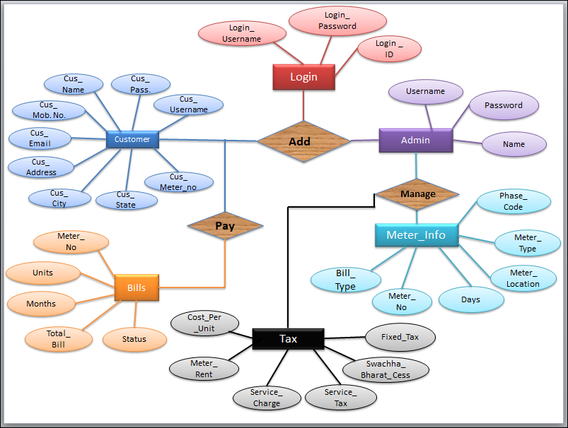
E-R Diagram :-
FIG 4.1.1 : ER diagram of Electricity Billing System.

Slide 7
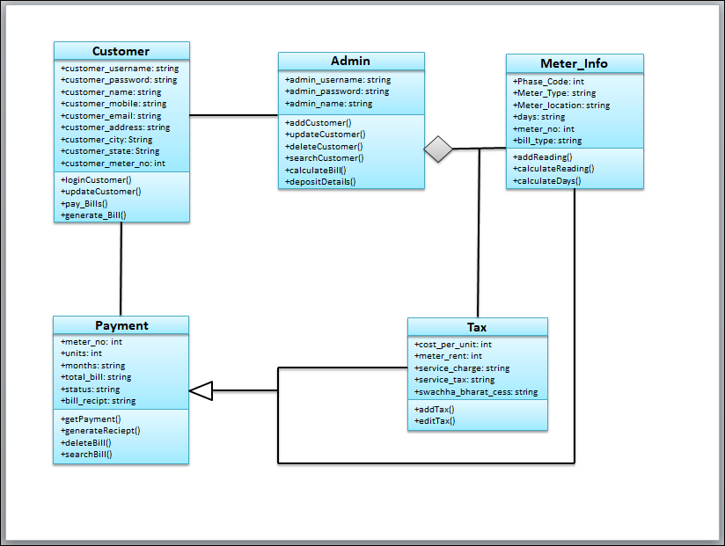
SYSTEM DESIGN AND MODELLING
Class Diagram :-
FIG 4.1.2 : Class diagram of Electricity Billing System

Slide 8
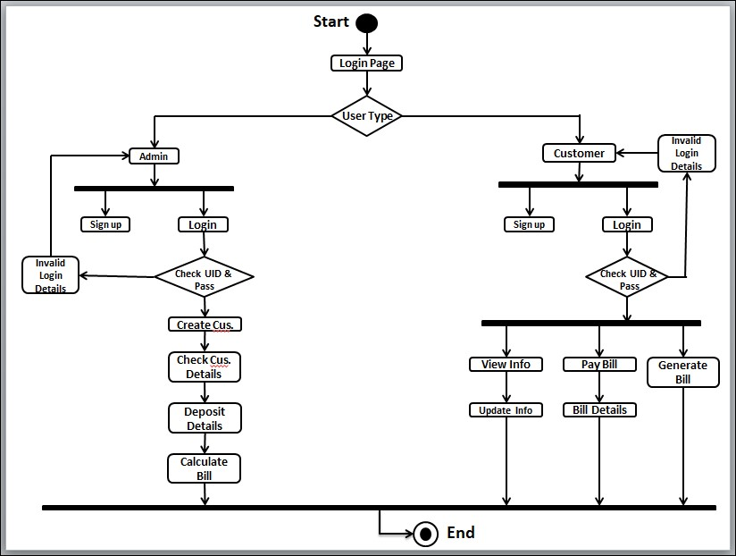
Activity Diagram :-
FIG 4.1.3 : Activity diagram of Electricity Billing System

Slide 9
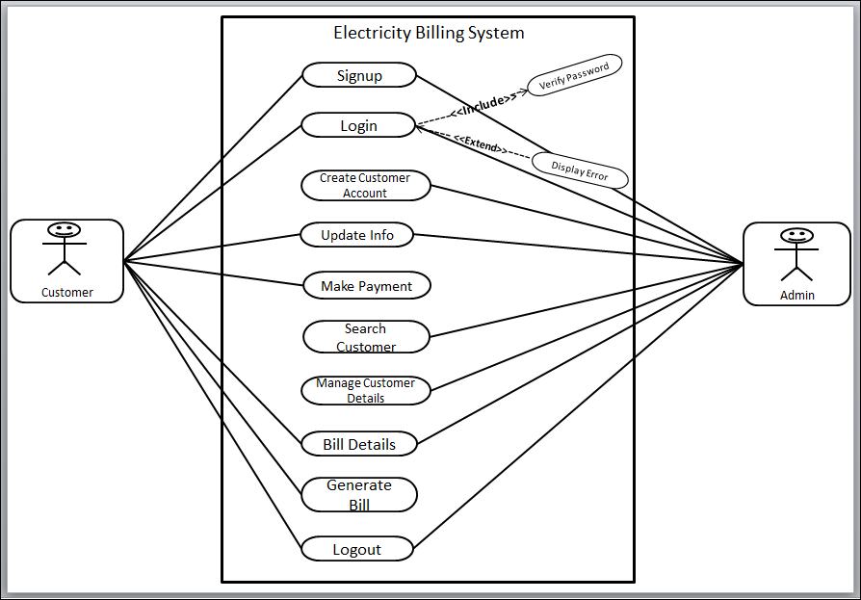
Use Case Diagram :-
FIG 3.1.4 : Use Case diagram of Electricity Bill Payment System:

Slide 10
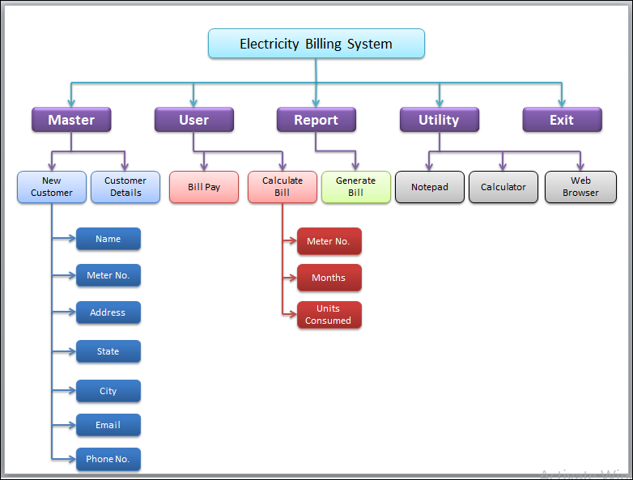
Module Hierarchy Diagram :-
FIG 3.1.5 : Module Hierarchy diagram of Electricity Billing System.

Slide 11
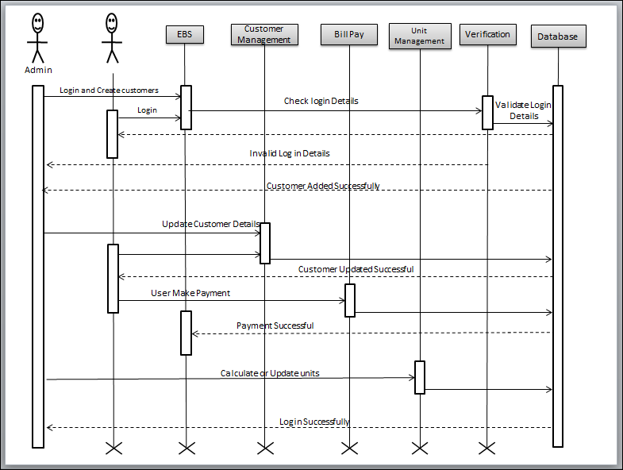
Sequence Diagram :-
FIG 3.1.5 : Sequence Diagram of Electricity Billing System.

Slide 12
CONCLUSION
After all the hard work is done for electricity bill management system is here. It is a software which helps the user to work with the billing cycles, paying bills, managing different DETAILS under which are working etc.
This software reduces the amount of manual data entry and gives greater efficiency. The User Interface of it is very friendly and can be easily used by anyone.
It also decreases the amount of time taken to write details and other modules.

Slide 13
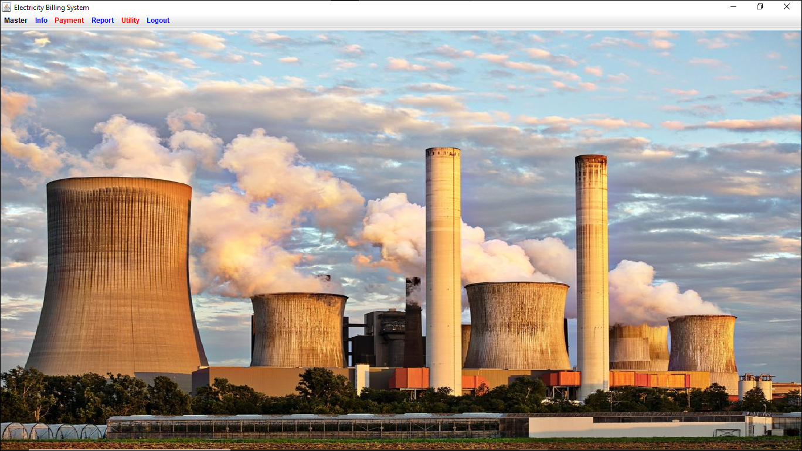
Snapshots:-
Home page :-
FIG 5.1.1 : Home page

